Slide 1
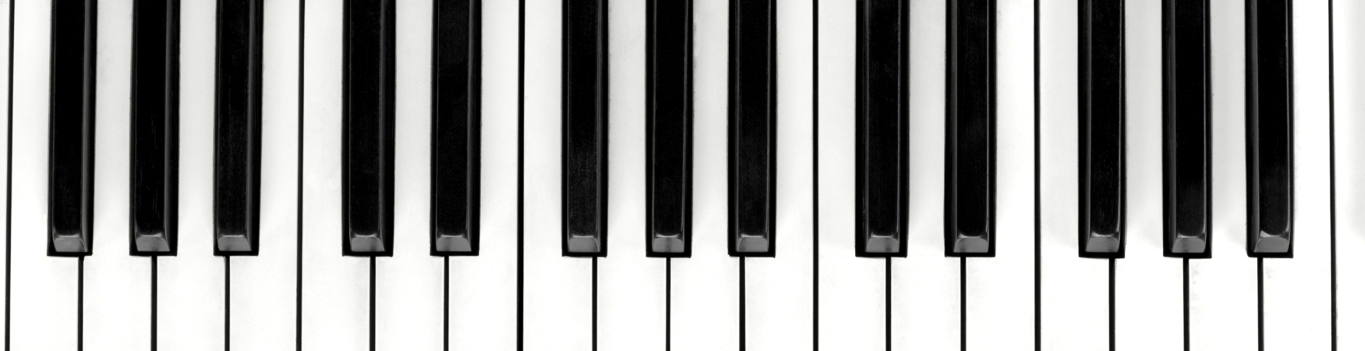
Piano Basics
Free Knowledge Mission

Slide 2
What we’ll cover
Brain exercises
Finger posture
Piano sizes
Key/Note locations
Intervals
Chords
Practice

Slide 3
Train your Brain
Part of learning the psychological component
You don’t have to be a child to learn
Anyone can play with both hands

Slide 4
Finger Terminology
Finger count 1 - 10
Curve your fingers – Play with a straight wrist
First three fingers play C,D,E then tuck your thumb to play F,G, A, B

Slide 5
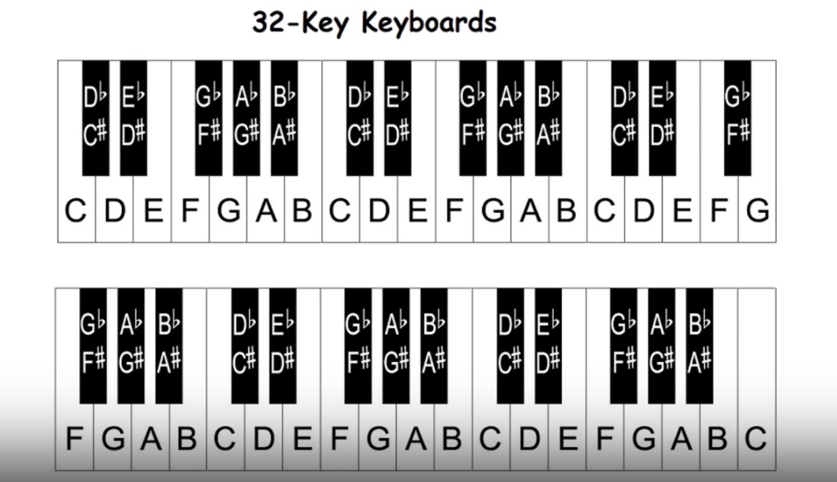
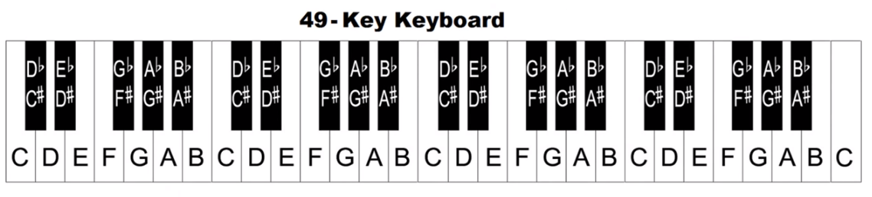
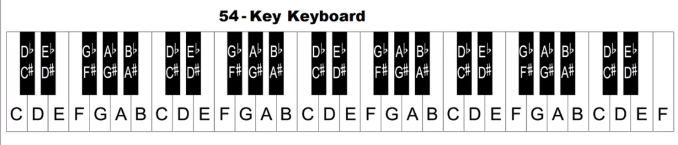
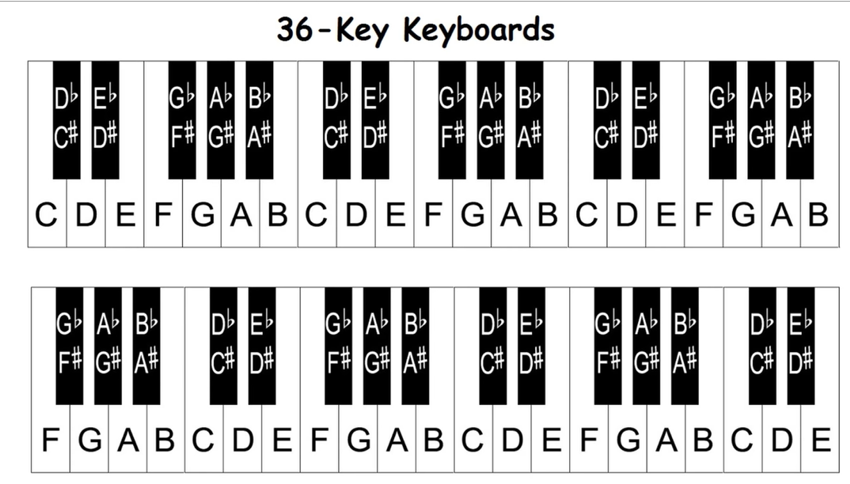
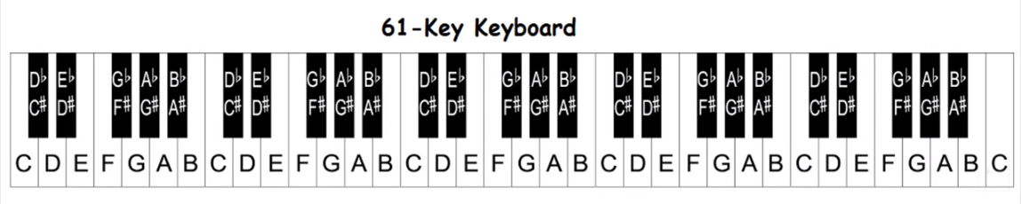
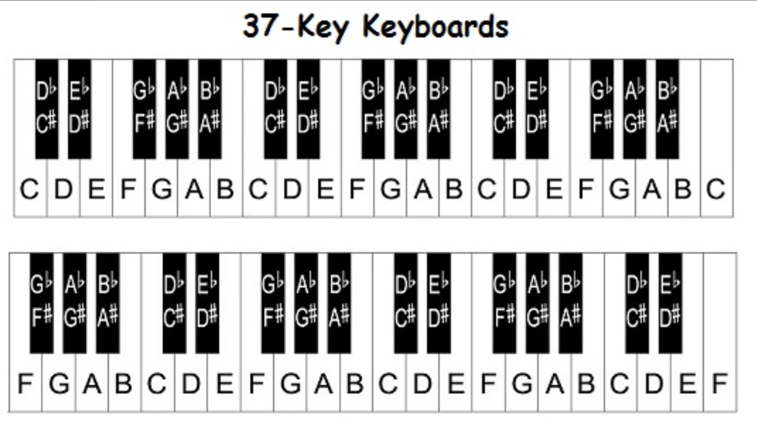
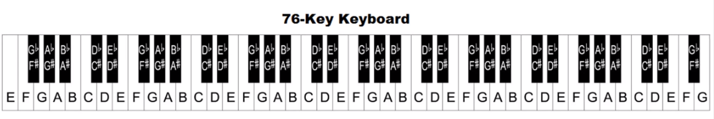
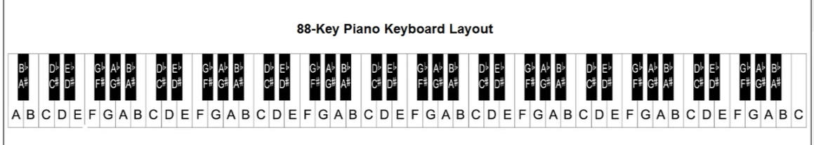
Common Keyboard Sizes

Slide 6
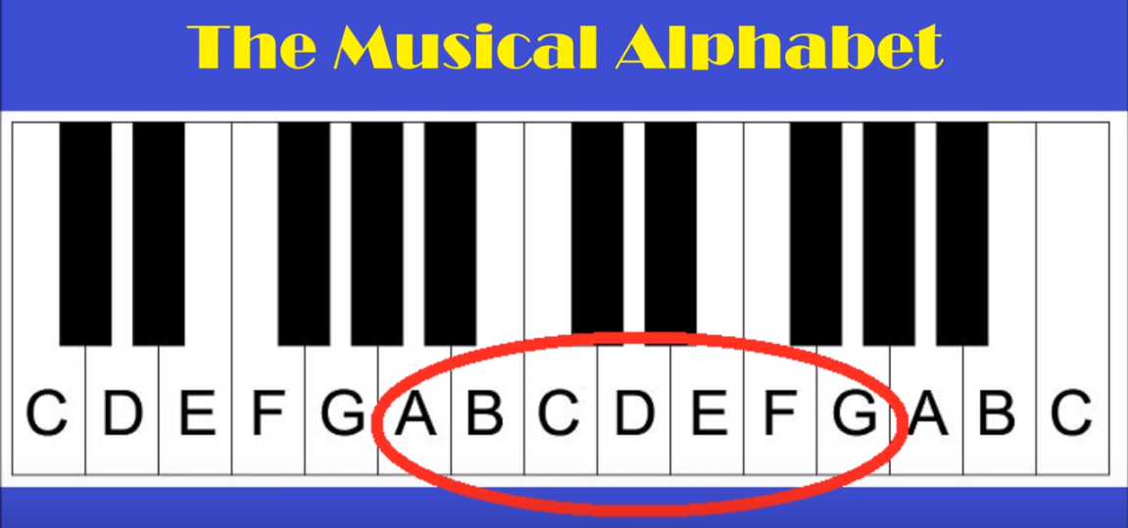

Slide 7
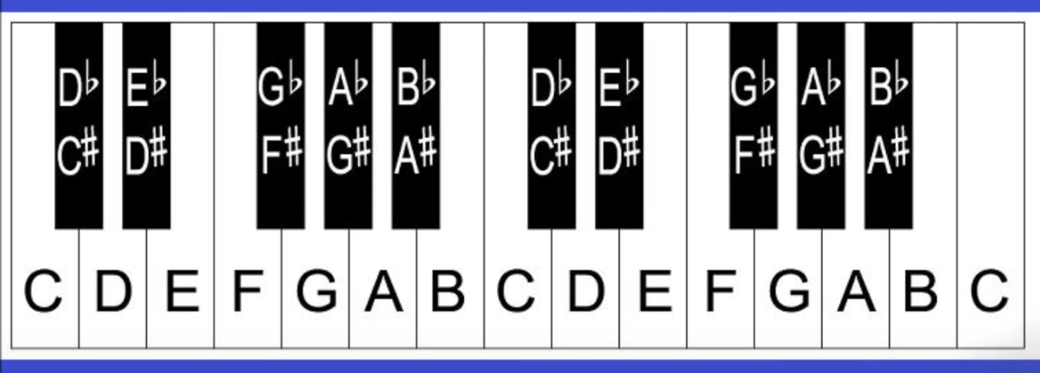
Keyboard Layout

Slide 8
Intervals & Scales
Semi-tone – half step/note up or down
Whole tone – two steps/notes up or down
8 natural notes or 13 notes in an octave
Practice playing an octave up and down

Slide 9
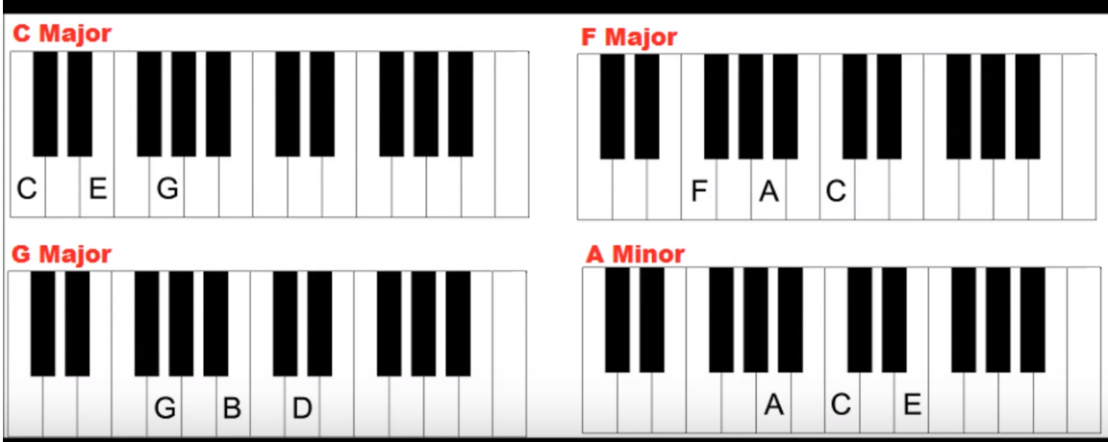
Chords
Chord: Group of three or more notes played together to create harmony.
A three note chord is called a triad containing three different notes played at the same time
Chord inversion is moving down two notes.
Minor Chord consists of root plus minor third plus perfect fifth of major scale. Example: Notes of A minor chord are A-C-E

Slide 10
Practice Songs
Songs with chords
Happy Birthday
Hot Cross Buns
Twinkle Twinkle

Slide 11
Resources
Piano Keyboard Guide

